Slide 1

Expand course1-Colorful water light
Yahboom
Yahboom OMIBOX Tutorial

Slide 2
1
2
3
4
5
Learning
goals
Search for
blocks
Combine
blocks
Experimental
phenomena
Preparation
程序编程
Tencent
Yahboom OMIBOX Tutorial

Slide 3
1
Preparation-1
1. The position of the RGB lights in the robot car
2. Learn how to use RGB lights graphically program building blocks
3. Learn how to control RGB light by graphical programming
Yahboom OMIBOX Tutorial

Slide 4
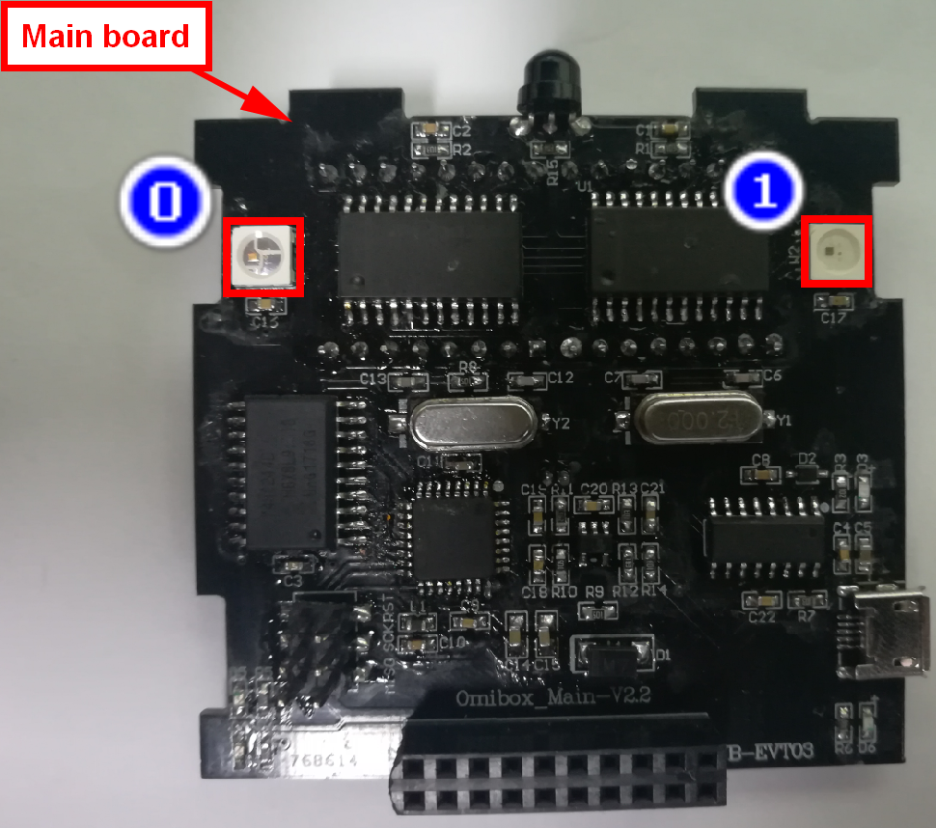
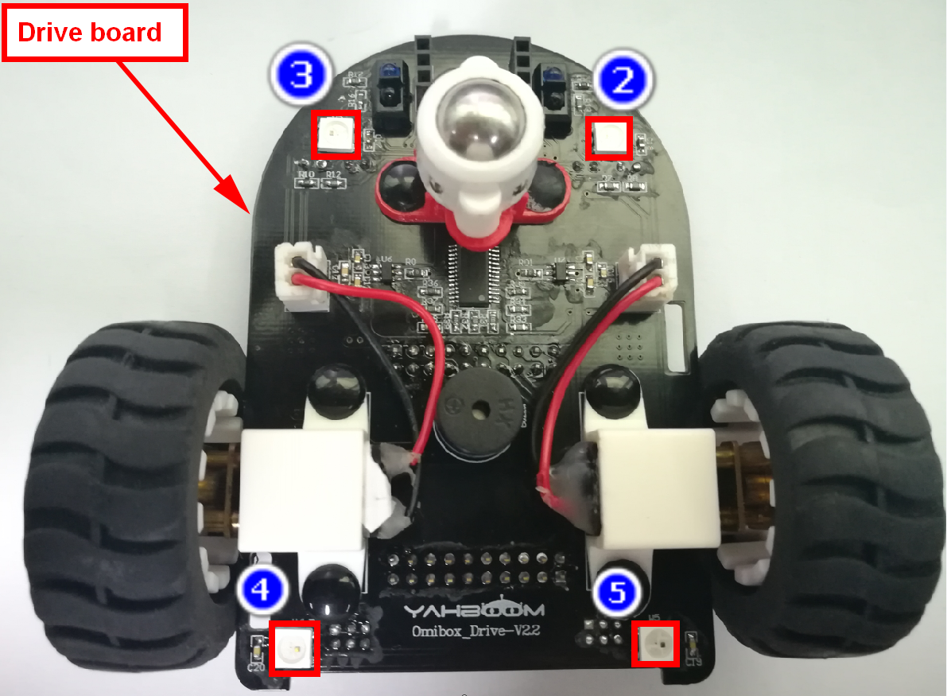
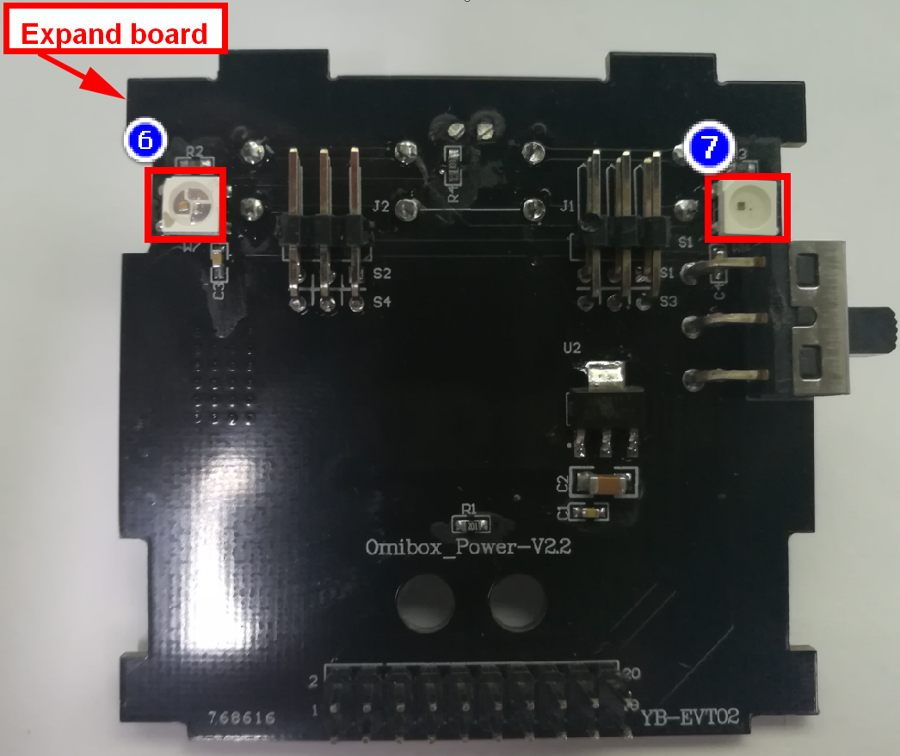
1
Preparation-2
As shown in the above picture, we circled the white square with a red wire frame. This white square is the RGB light on the Omibox. We can use the program to make different colors and brightness.
Yahboom OMIBOX Tutorial

Slide 5
2
Learning goals
In this lesson, we will learn to light up 8 RGB lights on the Omibox robot to achieve the experimental effect of the water light.
Yahboom OMIBOX Tutorial

Slide 6
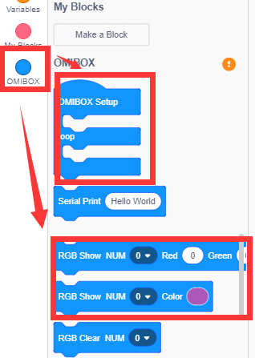
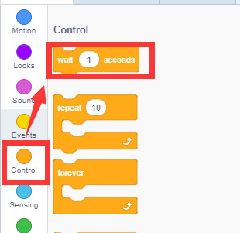
3
Search for blocks
The following is the location of the building blocks required for this programming.
Yahboom OMIBOX Tutorial

Slide 7
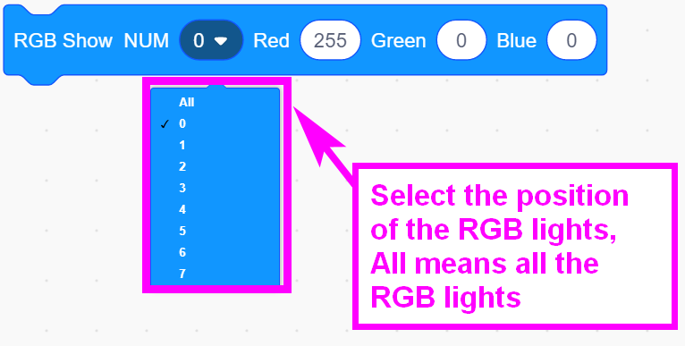
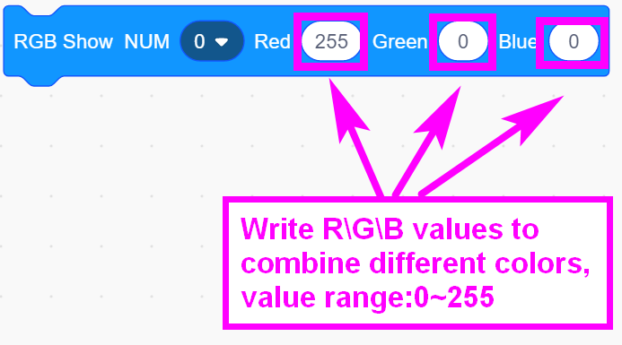
3
Search for blocks
Yahboom OMIBOX Tutorial

Slide 8
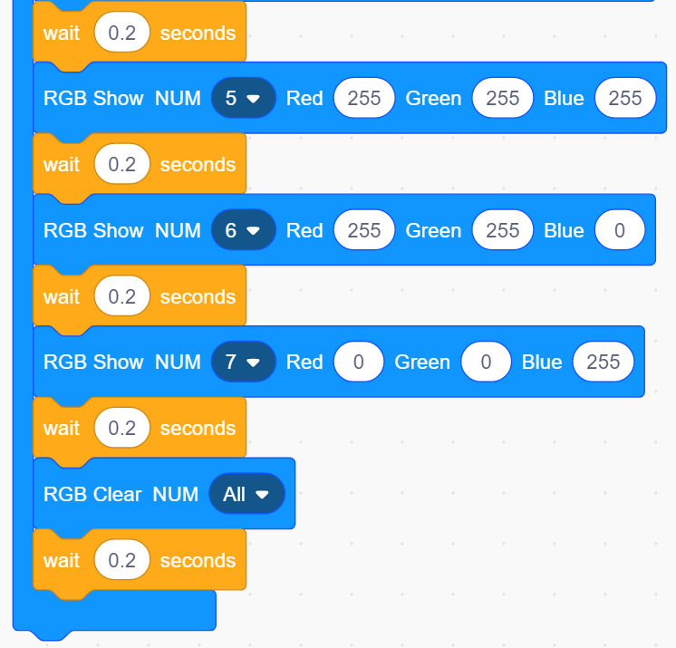
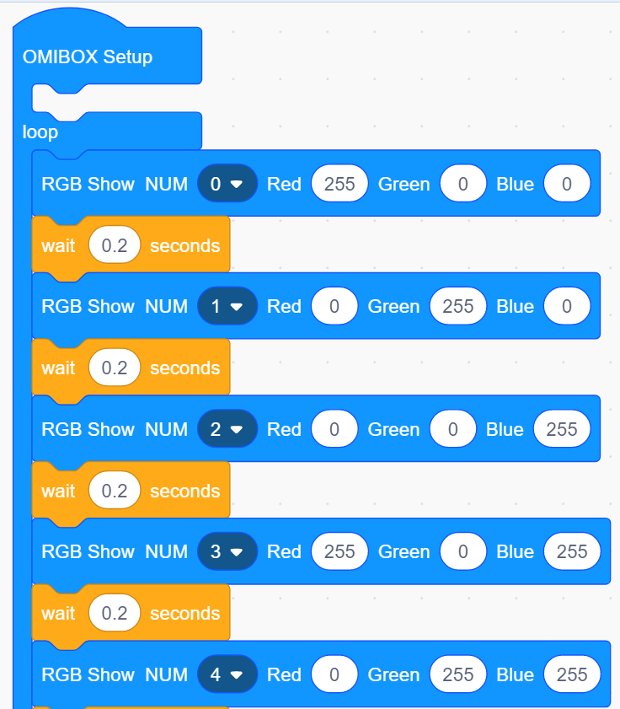
4
Combine blocks
The summary program is shown below:
Yahboom OMIBOX Tutorial

Slide 9
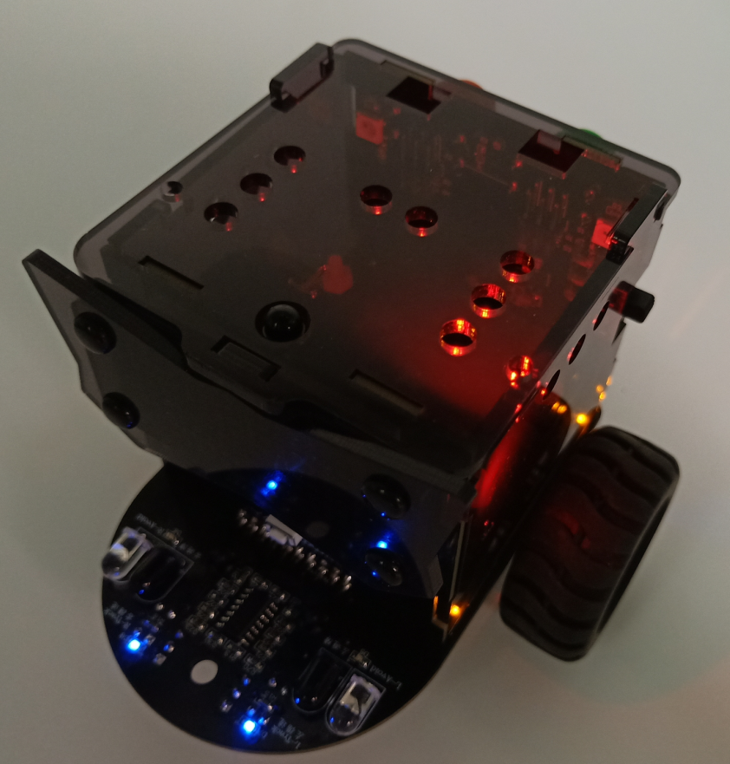
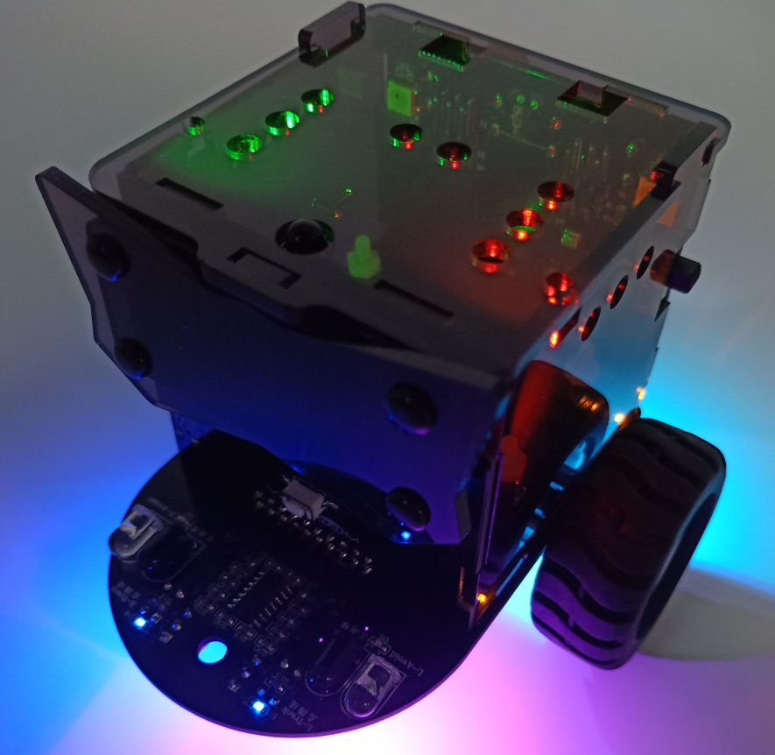
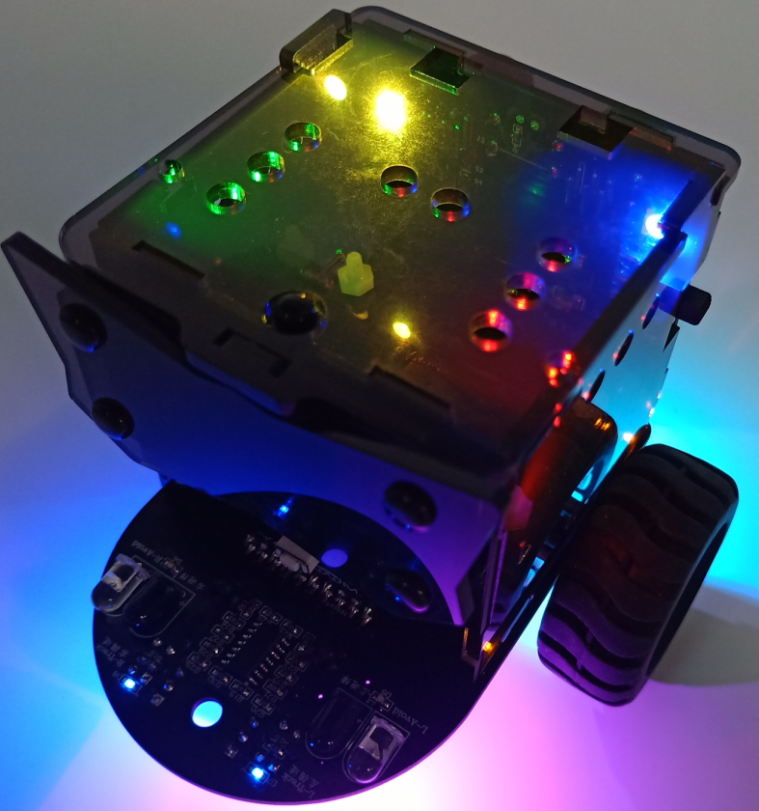
5
Experimental phenomena
After the program is uploaded, open the power of the car. We can see that the 8 RGB lights on the Omibox robot are lit up in turn, which looks like water light.
Yahboom OMIBOX Tutorial

Slide 10
Inspire Creativity Embrace Innovation
Thank you!!!
Yahboom

